Slide 1
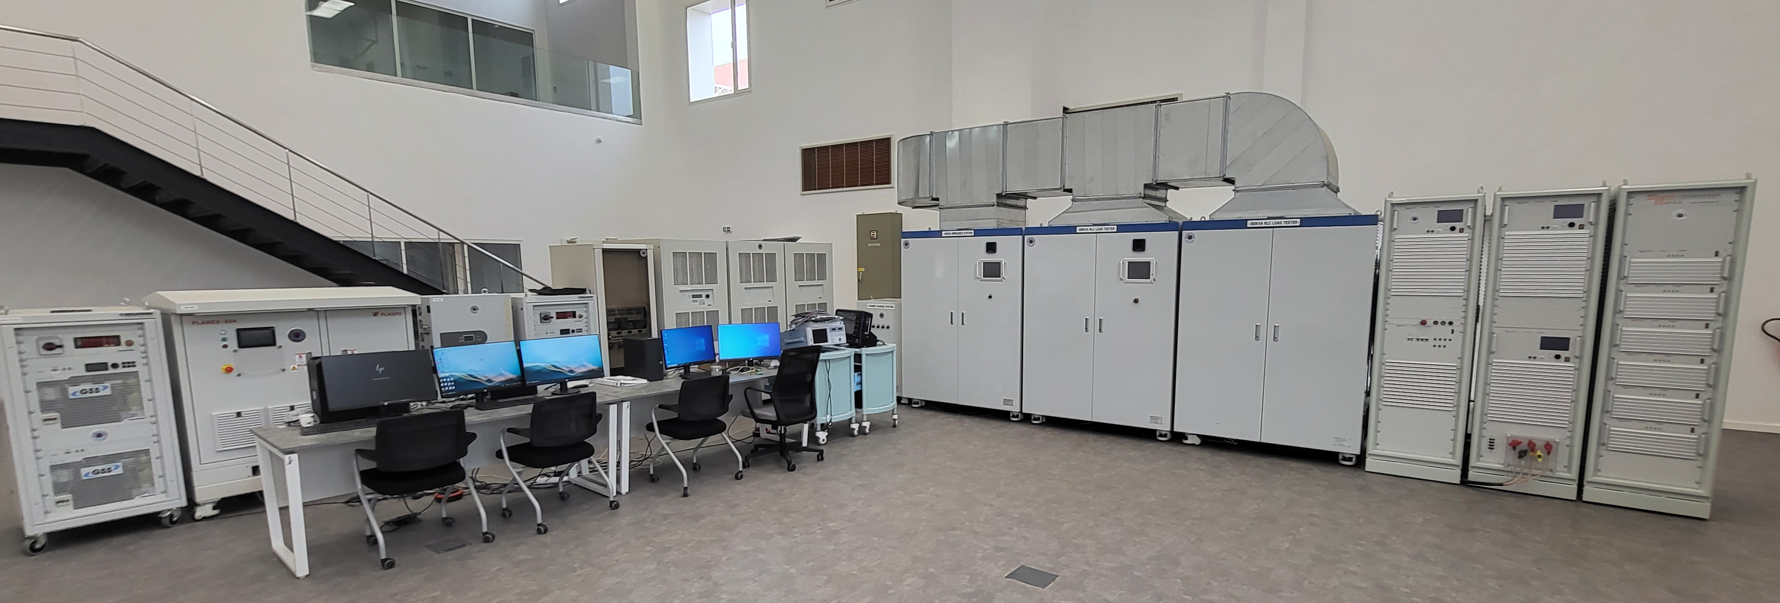
WithBEER Built a 300 kW Microgrid Testbench Including a SCADA System
Challenge
Establish a testbench environment for PV PCS efficiency tests, ESS PCS efficiency tests, islanding prevention tests, LVRT/HVRT tests, and line impedance simulation tests
Solution
Use Simscape Electrical and Simulink Real-Time to build integrated systems with power amplifiers and Microgrid testbenches using the OPAL-RT simulator and integrate with SCADA systems using Speedgoat
Results
Algorithms are tested and automated for various experiments
Ease of maintenance and high usability were secured
Easy-to-use real-time simulator created through app development
“As part of the KOICA-led project and Moroccan Green Technology Research and Development Comprehensive Support Project, we designed and built the entire system configuration of a 300 kW microgrid testbench and built an MBD-based SCADA so that local researchers could utilize it. MATLAB, Simulink, and Simulink Real-Time provided technical support and added various functions to the built system.”
— Hyungrok Oh, WithBEER
Notes:
Industries: Utilities
Application Areas: Realtime simulation
Capabilities: Algorithm Development, Power HILS
Products Used: Simscape Electrical, Simulink Realtime
Country: Korea

